Slide 1
Team Members:
M.Nikhil Kumar
G.Srujan Kumar
K.Venkatesh
A.Harish
DIRECTIONS
via
SMS
Project Mentor:
D. Dakshayani Himabindhu
(Assistant Professor)

Slide 2
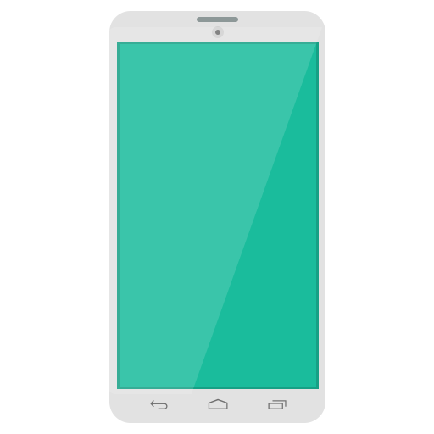

Problem
Getting directions to a place is difficult
WITHOUT internet WITHOUT smart phone

Slide 3
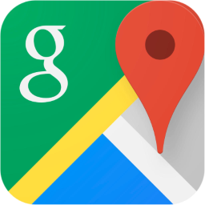
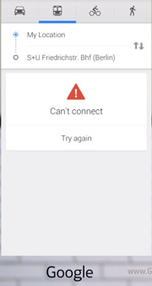

Problem
Even if we have internet, Google Maps
may be slow needs more data -> more money

Slide 4



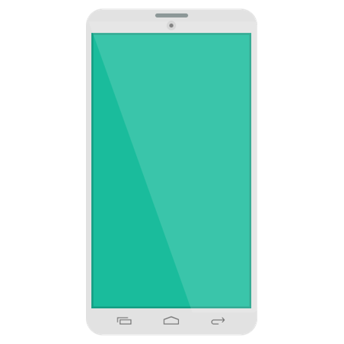
Solution – Our Product
Get directions with SMS.
Phone
Server

Slide 5
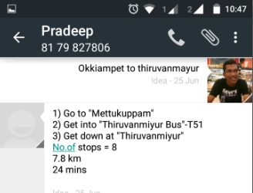
How it works?
Request:
‘Origin’ to ‘Destination’ [transit mode]
Response:
Step by step directions to the destination

Slide 6
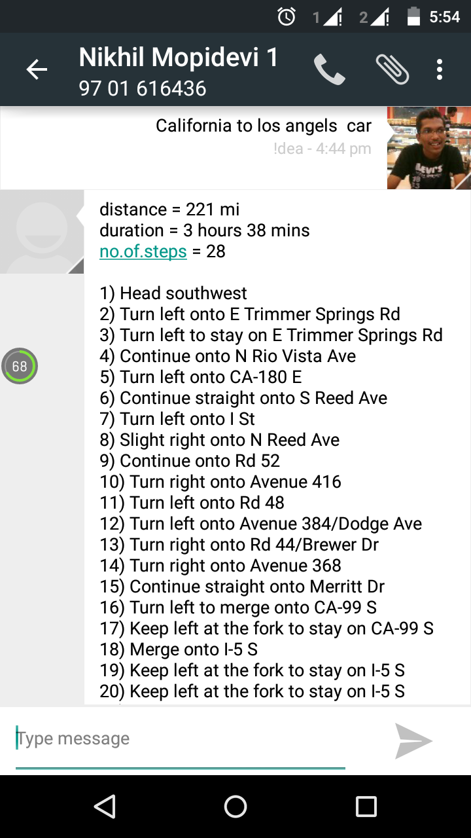
Our Product
Our service can be used globally.

Slide 7
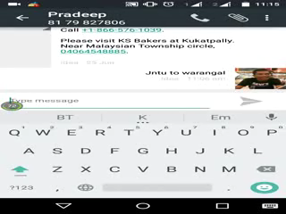
Demo Video

Slide 8
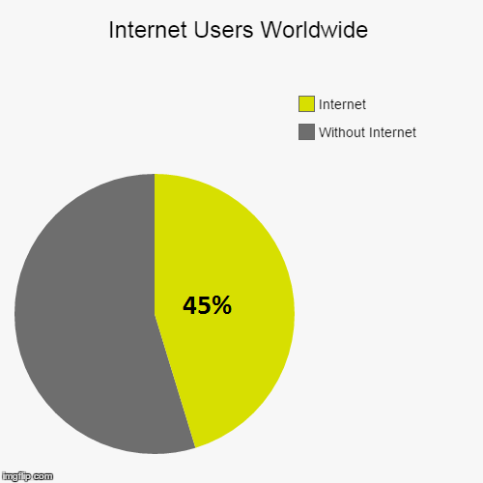
*Source : www.statista.com
Internet Reach
Even in 2015,
only 3.16 billion out of
7 billion access internet.

Slide 9
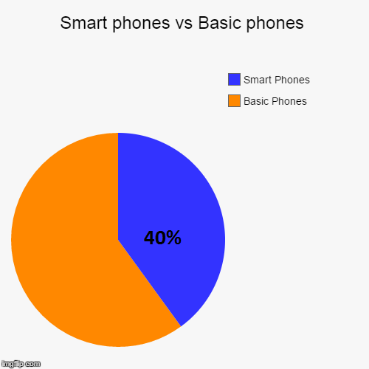
*Source : www.statista.com
Smart Phone Penetration
Even in 2015,
only 1.9 billion phones out of 4.8 billion are Smart Phones.

Slide 10

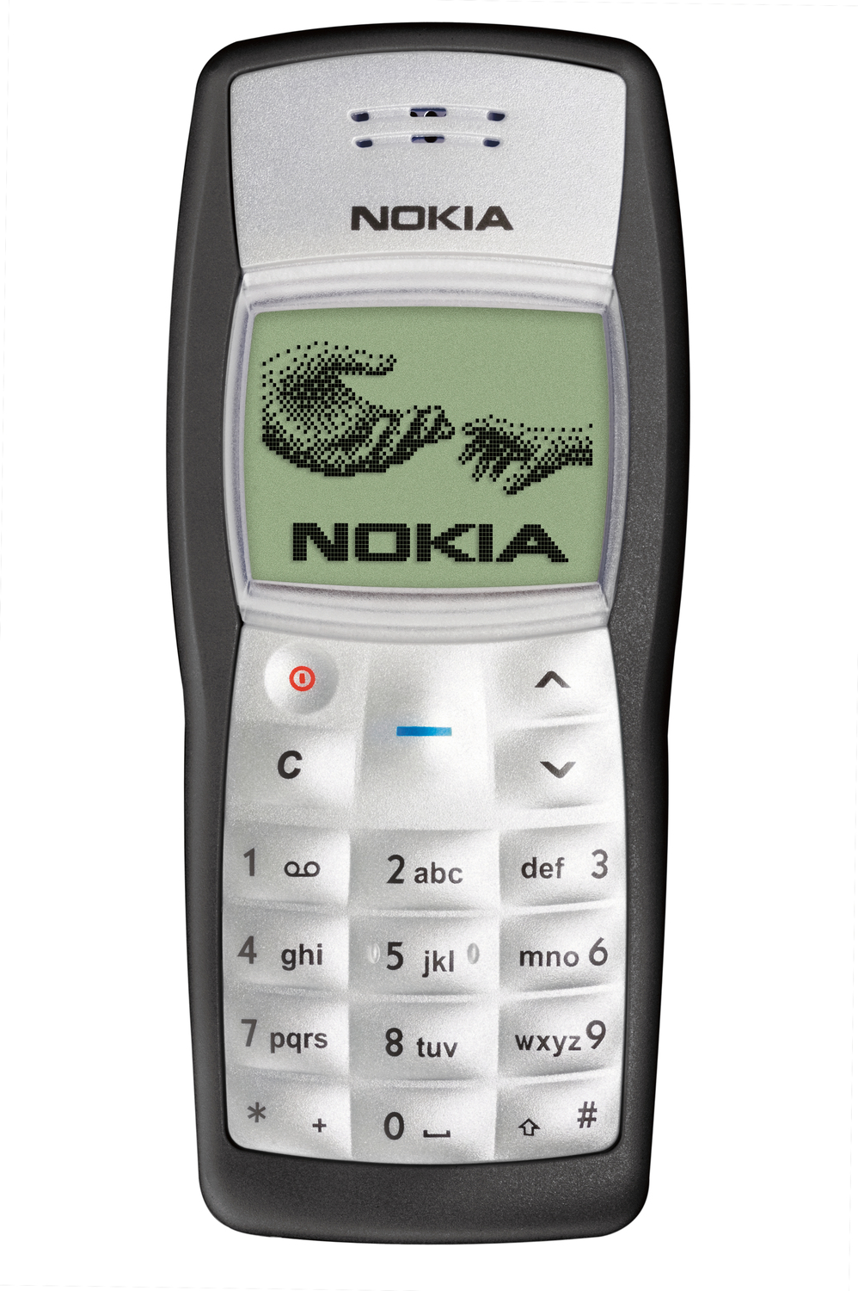
YES
YES
NO
YES

Slide 11
Why our Product?
No Internet needed
No Smart phone needed
No Installation, No downloading
4.8 billion potential users

Slide 12
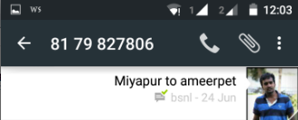


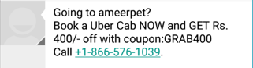
Revenue Streams
Location based Cab Services

Slide 13

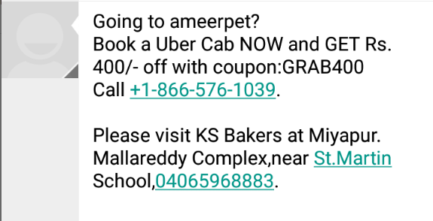

Revenue Streams
Location based Advertisements

Slide 14
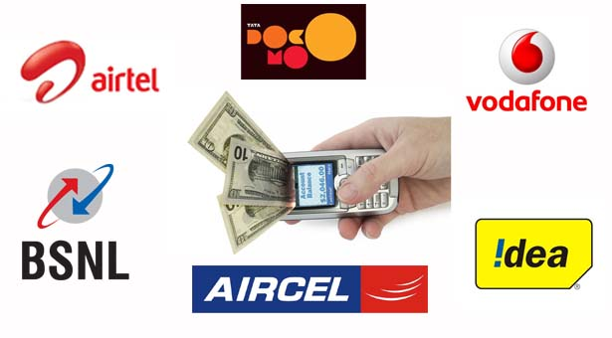
Revenue Streams
Telecom Service providers
Complete integration with network providers
Partial collaboration

Slide 15
Add-ons
Future Enhancements :
Translation into native languages
Dynamic Ad generation based on location

Slide 16
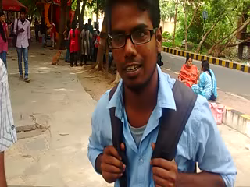
Feedback

Slide 17
Thank you

